Slide 1

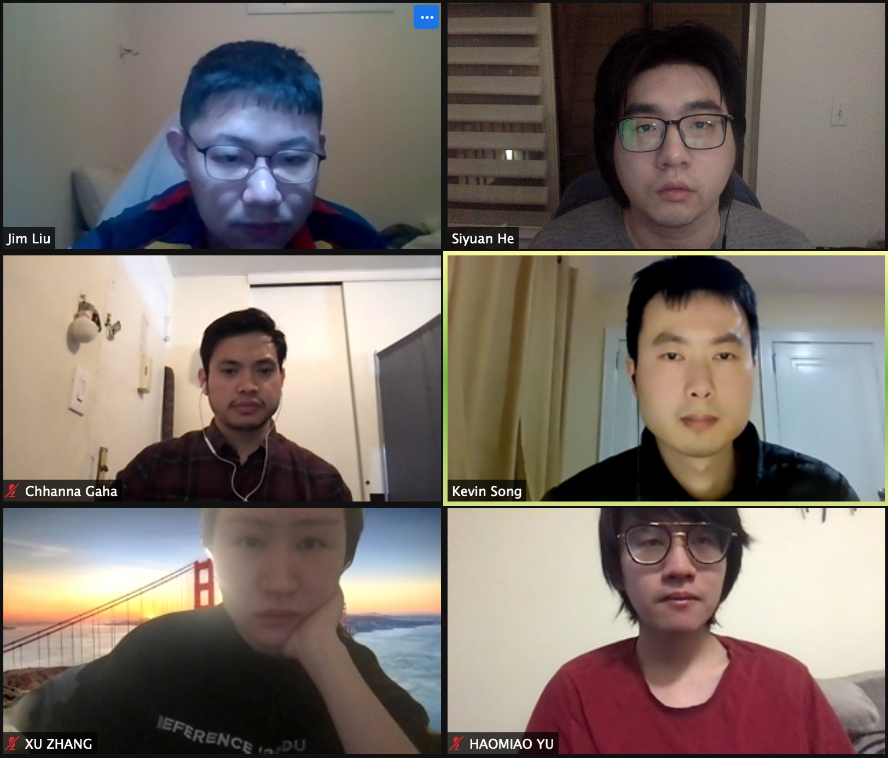
PC builder web application
Team member:
Kevin Song
Siyuan He
Xu Zhang
HaOmiao Yu
Chhanna Gaha
Sichao Liu
Guided By: Professor Henry Wong
Deliverable VIII
Team Name: Dice

Slide 2
Agenda
Introduction
Personas
MVP
Comparison: Sprint 7 vs Sprint 8
Sprint Recap & Product Backlog Overview
Sprint 8 Test Cases
Technologies Used
Spring 8 Backlog
Burndown Chart
Timeline
Retrospectives
Project Demo

Slide 3

Introduction
A new application is made if a developer produces a new idea or when there is new technology to create better software. Our team viewed many existing online PC hardware stores, realized that they are either created with older development tools or lacking modern functions that users need nowadays.
Therefore, we are here with a web application that is developed using React and other advanced technologies to achieve smooth browsing and satisfying functionality. The web app will help users select and purchase the right hardware for their requirements. Users can see what other users’ review for different builds to help them determine if they meet their needs.

Slide 4
Persona of a college Student
Hi, I am Nancy studying Bachelor's in Computer Science at North Georgia University. It’s difficult for me to pick a laptop out of many brands. There are ASUS, MSI, Dell and so many famous brands with similar hardware specs. I wish there was a good online application to help me identify which brand has the best hardware with the best price.

Slide 5
Persona of a software engineer
Hi, I am Jz Han. I am an experienced IT worker living in the Georgia suburb. In Georgia, the retail store is far away from where I live so I always shop for PC parts online. However, the websites that I am familiar with are only office related. They do sell PC hardware but it’s not their major business. I wish there was a web application that would just focus on selling PC parts. It would need to have a clear category breakdown and run smoothly just like any other shopping website.

Slide 6
Persona of a FilMmaker
Hi, my name is Mark. I’m an MFA of Filmmaking in the School of Visual Arts in New York. Next semester I will take classes related to video editing and color correction and I’m using 4K videos instead of 1080p videos. I’m changing my main editing tool from Adobe Premiere to Davinci Resolve. I have a great Gaming Desktop and it worked well with Premiere, but after moving to Davinci it runs much slower. I was told that I need a more powerful CPU to make the Davinci work perfectly. But the current processor manufacturers have made their product numbering too complicated, and it‘s hard for someone like me who lacks hardware knowledge to pick the processor I need. I hope there will be a website that could show me the configurations of different performance levels of computers where I could find the CPU I need and place an order directly on the website.

Slide 7
Persona of a Gamer
Hi, I am Jessi, a Bachelor at Pace University. I’m a big fan of AAA PC gaming so I plan to buy a powerful desktop which can be used for heavy gaming as well as course work. However, the gaming desktop currently on the market is usually more expensive, so building a desktop by myself will save money while having the same performance. But I don‘t know how to pick hardware, it’s too complicated for me. I wish there was a website that sold custom built desktops so I could get a desktop with great gaming performance at a relatively low price.

Slide 8
MVP
Which problem does it solve?
For the customers who are not familiar with the computer specs and components, it is difficult to choose the right PC builds or laptops that meet their needs.
Minimum:
A tool that helps customers build their own PC quickly and easily.
Viable:
A tool that helps customers set up their own PC quickly and easily. For customers without computer-related knowledge, it allows them to pick the right hardware for their needs. Customers can provide their working software information, budget, and expected years of use to get hardware recommendations. After selecting your PC build, you can either purchase the hardware directly from the website or pay a service fee and have it installed and delivered to you.
Minimum + Viable:
A tool that allows customers to select the right PC build for them while balancing budget and performance.

Slide 9
Comparison: Sprint 7 vs 8 Sprint 7
Sprint 7
The database issue remaining from sprint 6 forced the team to finish the user management section in advance
We completed admin’s user management ability with only the edit user function remaining
Code optimization was done so the deployment process can be easier.
Our team complete 2 user stories out of 3. ( 66% of the commitment )

Slide 10
Comparison: Sprint 7 vs 8 Sprint 8
Sprint 8
Story ID | User type | I want be able to … | So that… | status
23 | Admin | Change user’s info as needed Tasks include: -Build API for update users -Create edit screen UI | I can list product for sale as a user | Done
24 | Seller | Have a seller page | User can now become seller | Skip
25 |  | Deploy Website | Website is officially good to use | Fail
1 out of 3 user stories completed. ( 33% of the commitment )

Slide 11

Sprint recap & Product Backlog Overview

Slide 12
Product Backlog Overview (Page1/3)
Story ID | Sprint | User type | I want to be able to… | So that … | type | status
1 | I | Developer | Install development tool | Team can start writing the app
2 | I | Developer | Design Website Template | Team can plan on HTML, CSS
3 | I | Developer | Install communication platform | Team members are free to communicate
4 | II | User/Admin | Have a website | I can view/order items, create profile… | story | done
5 | II | User/Admin | Visualized Product Components | I can display images and their info on website | story | done
6 | II | User/Admin | Have detailed Product Page | I can click on product to check their detail | story | done
7 | II | User | Have Shopping cart | I can check purchased product | story | done
8 | III | User/Admin | Register | I can use my profile to perform such as buying…. | story | done
9 | III | User/Admin | Login/Log out securely | My account is private | story | done
10 | III | User | Display added items on cart icon | I can see number of items in cart | story | done
11 | III | User/Admin | Edit qty of item in both product and check out page | I can freely edit item numbers. | story | done
12 | IV | User | Enter name and shipping address | I can have name and shipping stored in profile | story | done
13 | IV | User | I want to check out and have an order number | I can wait for my order | story | done
14 | IV | Admin | I want to see order placed by customer | I can send order by shipping address | story | done

Slide 13
Product Backlog Overview (Page2/3)
Story ID | Sprint | User type | I want be able to … | So that… | type | status
15 | V | User | Have profile displayed | I can see my profile | story | done
16 | V | User | Update my profile info | I can freely edit profile and save | story | done
17 | V | Admin | List Product | I can see all order in list | story | done
18 | VI | Admin | Create Product | I can create product on website | story | done
19 | VI | Admin | Update Product | I can edit product info on website | story | skip
20 | VII | Admin | Upload Product Image | I don’t have to upload image manually | epic | skip
20 a | VII |  | Define upload router |  | task
20 b | VII |  | Create uploads folder |  | task
20 c | VII |  | Edit code in frontend |  | task
21 | VII | Admin | List Users | I can list users out and check them | story | Done
22 | VII | Admin | Delete Users | I can remove unwanted user | story | Done
23 | VIII | Admin | Edit Users | I can change user’s info as needed | epic | Done
23a | VIII |  | Build api for update users |  | task | Done
23b | VIII |  | Create edit screen UI |  | task | Done

Slide 14
Product Backlog Overview (Page3/3)
Story ID | Sprint | User type | I want be able to … | So that… | type | status
24 | VIII | Seller | Have a seller page | I can list product for sale as a user | story | skip
25 | VIII | Everyone | Deploy website | Website is good to use | story | fail
26 | VIII | team | Communication among team members |  | retro | Done
27 | VIII | team | Team planning and participation |  | retro | Done
28 | VIII | team | Time management |  | retro | fail

Slide 15
Sprint 8 Test Cases
ID | Process | Test Case | Description | Status | Expected Result | Actual result
23 | Edit user | Click on edit button under user management | Login as admin and enter the user menu | Passed | Successfully sign in as admin and user menu is displayed after click | Admin user successfully logged in. User Menu successfully displayed
 |  | Change username and password | Enter a different name and password for user and click save | Passed | The mongoDB’s data is updated with the entered data | The password and username successfully changed
 |  | Change a normal user to admin | In the admin selection window mark a normal user to admin | Passed | The user now become admin | The user now become admin and can access all admin function.
25 | Deploy website | Update GitHub | Push all the change to GitHub and save | Passed | Whole application updated to GitHub | GitHub repository have the newest version of the app
 |  | Connect to mongo DB and Heroku | In Mongo DB create a cluster and generate link and give Heroku the access link | Fail | The website successfully deployed, and everything is now hosted on Heroku’s website | The Heroku refuse the link and the deployment failed

Slide 16




Technologies we used
React

Slide 17
Reasons we chose some of the technologies
React is an open-source, front end, JavaScript library for building user interfaces or UI components. The reusable components are suitable for our project.
MongoDB is a source-available cross-platform document-oriented database program. Classified as a NoSQL database program. We choose it as our database because it is fast and easy to use.
Node.js is primarily used for non-blocking, event-driven servers, due to its single-threaded nature. It is used for traditional web sites and back-end API services

Slide 18
SPRINT 8 BACKLOG
Story ID | Sprint | User type | I want be able to … | So that… | type | status
23 | VIII | Admin | Edit user | I can change user’s info as needed | story | Done
23a | VIII |  | Build api for update users |  | task | Done
23b | VIII |  | Create edit screen UI |  | task | Done
24 | VIII | Seller | Have a seller page | I can list product for sale as a user | story | Skip
25 | VIII | Everyone | Deploy website | Website is good to use | story | Fail
Overall, the team had good communication and participation. However, we did poorly on time management so some of the functions were not completed. (we complete 23 story out of 28. 82% commitment is done overall)

Slide 19
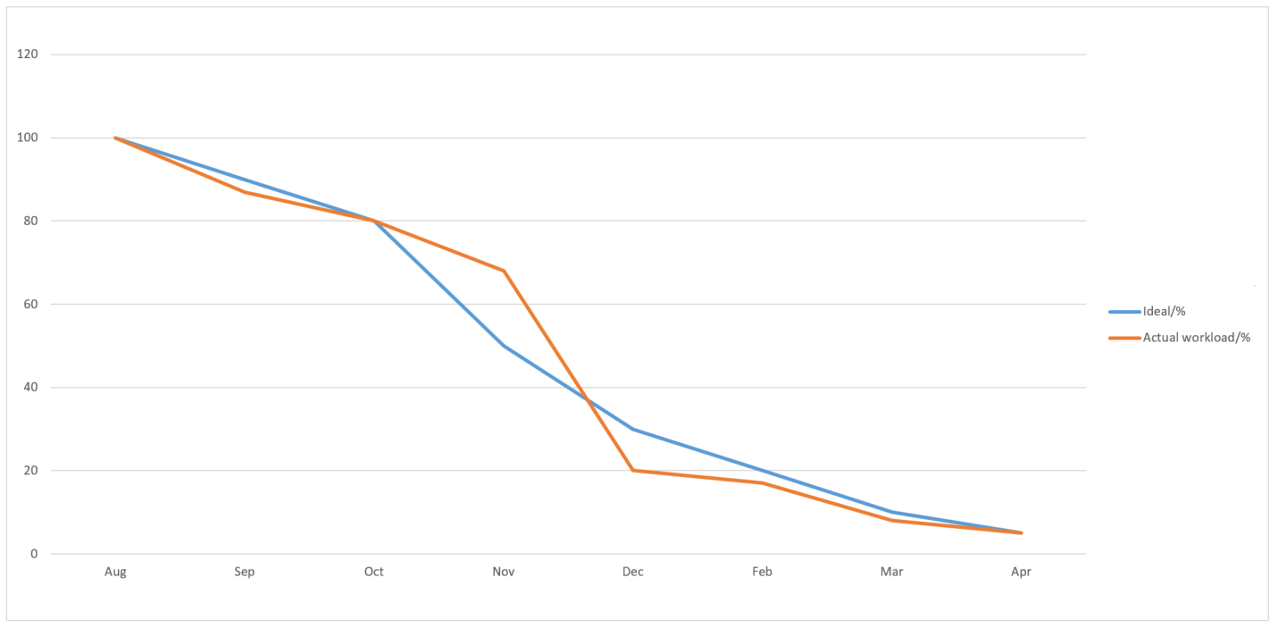
BURNDOWN CHART

Slide 20

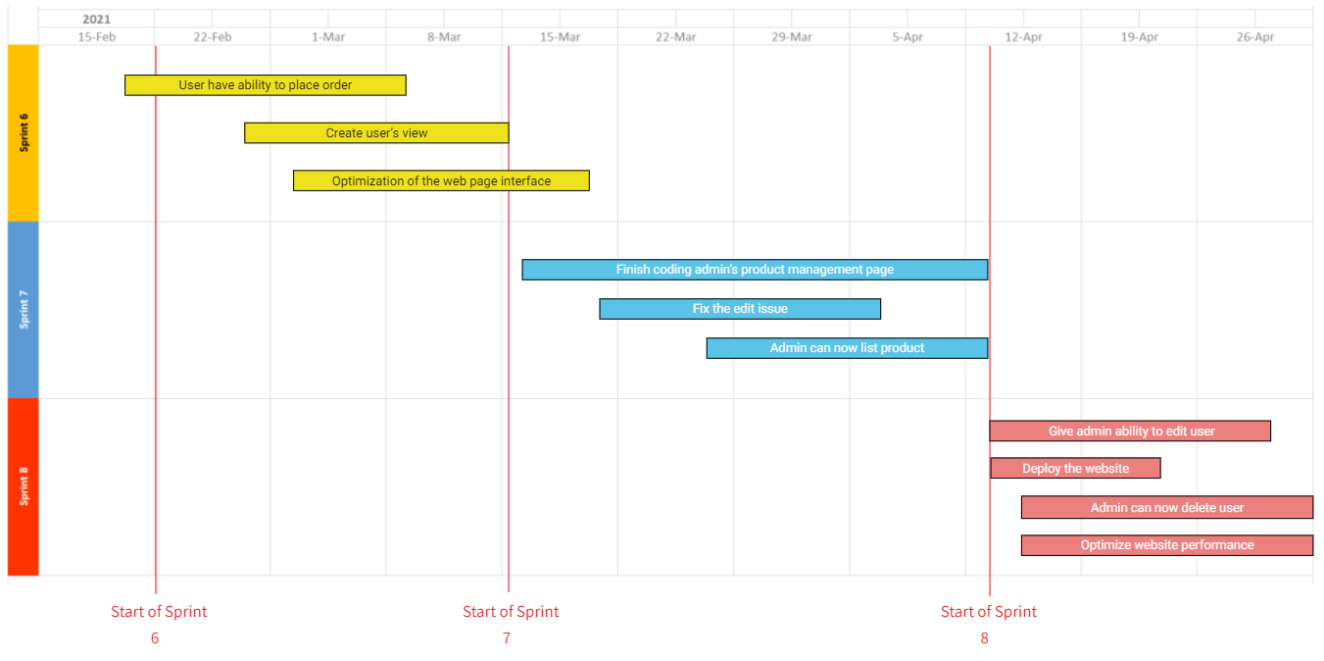
Project Timeline

Slide 21
Retrospectives
What went well
-Communication among team members (5 votes)
-Team planning and participation (3 votes)
What needs improvement
-Logging work consistently (4 votes)
-Time management (3 votes)
Next step
- The best way to improve our time management is to log our daily activities. It will help eliminate focusing too much on less important task so that we can become more productive. (4 votes)

Slide 22

GitHub link
https://github.com/ksong227/CS691TeamDice
Thank You

